Slide 1
Two-Sample t-Test Audity Ghosh
Understanding and Applying Hypothesis Testing on Two Datasets

Slide 2
Objectives
- Understand the concept of hypothesis testing using a two-sample t-test
- Apply the test to compare means of two independent samples

Slide 3
Theory
The two-sample t-test determines whether the means of two independent samples are significantly different.
Types:
1. Equal Variance (Pooled t-test)
2. Unequal Variance (Welch's t-test)

Slide 4
Equal Variance t-test (Pooled t-test)
The pooled t-test assumes that the two groups have the same variance (homogeneity of variance). It pools the variances from both samples to estimate a common variance.

Slide 5
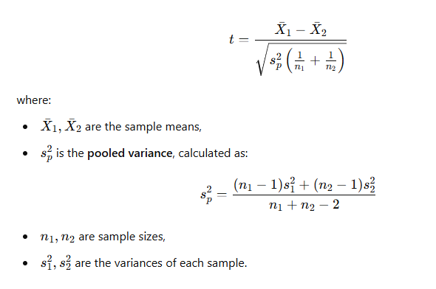
Equal Variance t-test (Pooled t-test)

Slide 6
Equal Variance t-test (Pooled t-test)
Example: Testing Exam Scores of Two Classes
Suppose we compare the exam scores of Class A and Class B, assuming their performance variability is similar.
Class A scores: [85, 90, 88, 92, 87, 89, 91, 86, 90, 88]
Class B scores: [78, 82, 80, 79, 81, 83, 77, 82, 80, 79]
We assume equal variance and apply the pooled t-test.

Slide 7
Unequal Variance t-test (Welch's t-test)
The Welch's t-test is used when the two groups do not have the same variance. It is more flexible and does not assume equal variances.
More robust for real-world data

Slide 8
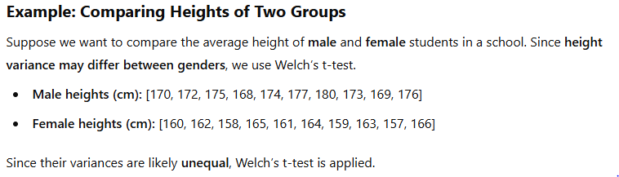
Unequal Variance t-test (Welch's t-test)

Slide 9
Two Sample T-Test
The two-sample t-test (also known as the independent t-test) is a statistical test used to compare the means of two independent groups to determine whether they are significantly different from each other.

Slide 10
Key Assumptions
The two samples are independent.
The data in each group are normally distributed
The variances of the two groups are equal (for the standard t-test) or unequal (for the Welch's t-test).

Slide 11
Hypothesis Testing Framework
Null Hypothesis (H0): The means of the two samples are equal (μ1 = μ2)
Alternative Hypothesis (H1): The means are not equal (μ1 ≠ μ2)
Significance Level (α): Commonly set to 0.05

Slide 12
Degrees of Freedom (df) in the Two-Sample t-Test
Degrees of freedom (df) represent the number of independent values that can vary in a statistical calculation. In the context of the two-sample t-test, df helps determine the shape of the t-distribution used to calculate the p-value.
The calculation of degrees of freedom differs between the Equal Variance (Pooled t-test) and Unequal Variance (Welch’s t-test).

Slide 13
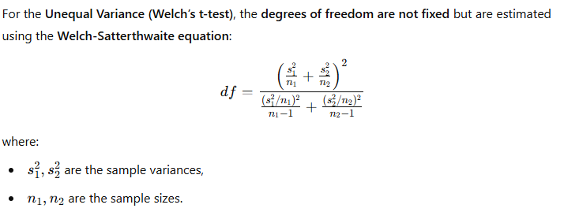
Degrees of Freedom (df) in the Two-Sample t-Test

Slide 14
Working Procedure
1. Define H0 and H1
2. Collect and define two independent datasets
3. Specify variance assumption (equal/unequal)
4. Perform the t-test using Python
5. Interpret results (t-statistic, p-value, confidence interval)

Slide 15
Example: Testing the Effectiveness of a New Drug
Scenario:
A pharmaceutical company wants to test whether a new drug (Drug A) is more effective in reducing blood pressure compared to a Amdocol Plus 50 (Drug B).
Group 1 (Drug A group): 10 patients took Drug A, and their blood pressure was measured.
Group 2 (Amdocol Plus 50 group): 10 different patients took Amdocol plus 50, and their blood pressure was also measured.

Slide 16
Example: Testing the Effectiveness of a New Drug
Collected Data (Systolic Blood Pressure after Treatment):
Drug A group: [120, 115, 118, 122, 119, 117, 116, 121, 120, 118]
Amdocol group: [130, 128, 132, 135, 129, 127, 126, 134, 133, 131]

Slide 17
Example: Testing the Effectiveness of a New Drug
Step 1: State the Hypotheses
Null Hypothesis (H₀): There is no difference in the mean blood pressure reduction between the two groups. (μ₁ = μ₂)
Alternative Hypothesis (H₁): There is a significant difference in the mean blood pressure reduction between the two groups. (μ₁ ≠ μ₂)

Slide 18
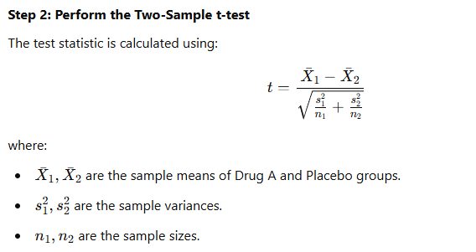
Example: Testing the Effectiveness of a New Drug
Amdocol

Slide 19
Example: Testing the Effectiveness of a New Drug
Step 3: Interpret the Results
If the p-value from the test is less than the significance level (usually 0.05), we reject the null hypothesis, meaning there is a significant difference in mean blood pressure reduction between Drug A and the placebo.
If the p-value is greater than 0.05, we fail to reject the null hypothesis, meaning there is no significant difference between the two groups.

Slide 20
Results
Results of the Two-Sample t-Test
t-statistic= -10.02
p-value = 8.64 × 10⁻⁹ (very small)
Interpretation
Since the p-value is much smaller than the common significance level (0.05), we reject the null hypothesis (H₀). This means there is a statistically significant difference between the mean blood pressure levels of the Drug A group and the Amdocol group.
In simpler terms, **Drug A has a significant effect in lowering blood pressure compared to the Amdocol**.

Slide 21
Interpretation of Results
- p-Value < 0.05 → Reject H0 (Significant difference in means)
- p-Value ≥ 0.05 → Fail to reject H0 (No significant difference)
- Confidence interval helps assess the mean difference

Slide 22
Conclusion of Scenario
If the test results show a significant difference, the company can conclude that Drug A is effective in reducing blood pressure compared to the Amdocol.
If not, there is no strong statistical evidence to support the claim that Drug A is better.

Slide 23
Two-Sample t-Test: Comparing Two Independent Means
The two-sample t-test is a statistical method used to compare the means (averages) of two independent groups and determine whether the difference between them is statistically significant.
🔹 Independent samples mean that the groups do not affect each other. 🔹 This test helps answer the question: "Is there a real difference between the two groups, or is it just due to random chance?"

Slide 24
Two-Sample t-Test: Comparing Two Independent Means
Example:
Suppose we want to check if a new diet plan helps in weight loss. We take two groups of people:
Group 1 follows the new diet plan.
Group 2 follows their regular diet.
We measure their average weight loss after one month and perform a two-sample t-test to check if the difference in average weight loss is significant.

Slide 25
p-Value: Understanding Statistical Significance
The p-value tells us how likely we are to get our test results if the null hypothesis (H₀) is true.
🔹 Null Hypothesis (H₀): There is no real difference between the means of the two groups. 🔹 Alternative Hypothesis (H₁): There is a real difference between the means.

Slide 26
p-Value: Understanding Statistical Significance
Key Interpretation of the p-value:
If p > 0.05, we fail to reject H₀ → No significant difference between the groups.
If p < 0.05, we reject H₀ → Significant difference between the groups.
Example:
If the p-value is 0.02, it means there is a 2% chance that the observed difference in weight loss happened by random chance. Since 0.02 < 0.05, we reject the null hypothesis and conclude that the diet significantly affects weight loss.

Slide 27
Confidence Interval (CI): Estimating the True Difference
The confidence interval (CI) gives us a range of values where we expect the true difference in means to lie.
🔹 If the CI includes 0 → The difference is not statistically significant. 🔹 If the CI does not include 0 → The difference is statistically significant.

Slide 28
Confidence Interval (CI): Estimating the True Difference
Example:
If the 95% confidence interval for weight loss difference is (1.5 kg, 4.2 kg):
Since 0 is not in this range, we conclude that the diet has a significant effect.
We are 95% confident that the true difference in weight loss between the groups is between 1.5 kg and 4.2 kg.
However, if the CI was (-0.5 kg, 2.3 kg):
Since 0 is in this range, we cannot confidently say the diet is effective.

Slide 29
Variances: Why We Used the Unequal Variance t-Test (Welch’s t-Test)
🔹 Variance measures how much the data points in each group spread out from the mean. 🔹 If the two groups have very different variances, the standard t-test may not be reliable. 🔹 Welch’s t-test is more robust and does not assume equal variances.

Slide 30
Variances: Why We Used the Unequal Variance t-Test (Welch’s t-Test)
Example:
Group 1 (Diet plan): Weight loss values vary a lot (some lose 5kg, some lose 0.5kg).
Group 2 (Regular diet): Weight loss values are more consistent.
Since the two groups have different variances, the Welch’s t-test is the better choice.

Slide 31
Importance of Choosing the Right t-Test
This experiment shows that choosing the correct version of the t-test is essential.
🔹 If variances are equal, we use the pooled t-test (Student’s t-test). 🔹 If variances are unequal, we use Welch’s t-test. 🔹 Interpreting the p-value and confidence interval helps in decision-making.

Slide 32
Importance of Choosing the Right t-Test
Example Decision:
If our t-test proves the diet plan is effective, the company can confidently promote it. If the t-test shows no significant difference, they may need to rethink their marketing.

Slide 33
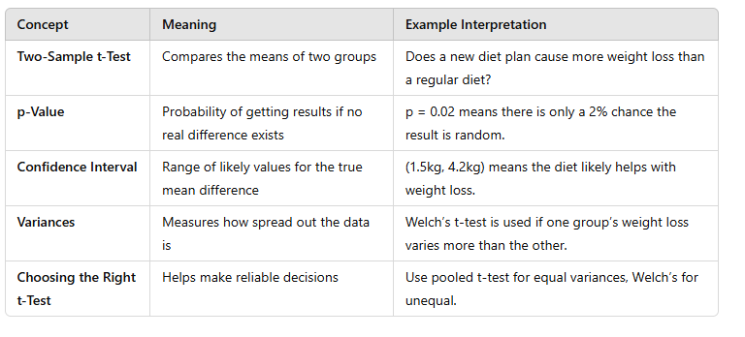
Summary

Slide 34
Conclusion
The two-sample t-test is a powerful method to compare means of two independent samples. Understanding variance assumptions and interpreting results correctly is crucial for data-driven decision-making.

